Slide 1
Chapter 3
Arithmetic for Computers

Slide 2
Arithmetic for Computers
§3.1 Introduction
Operations on integers
Addition and subtraction
Floating-point real numbers
Representation and operations

Slide 3
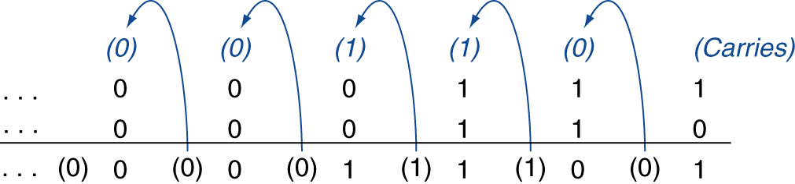
Integer Addition
Example: 7 + 6
§3.2 Addition and Subtraction
Overflow if result out of range
Adding +ve and –ve operands, no overflow
Adding two +ve operands
Overflow if result sign is 1
Adding two –ve operands
Overflow if result sign is 0

Slide 4
Integer Subtraction
Add negation of second operand
Example: 7 – 6 = 7 + (–6)
+7: 0000 0000 … 0000 0111 –6: 1111 1111 … 1111 1010 +1: 0000 0000 … 0000 0001
Overflow if result out of range
Subtracting two +ve or two –ve operands, no overflow
Subtracting +ve from –ve operand
Overflow if result sign is 0
Subtracting –ve from +ve operand
Overflow if result sign is 1

Slide 5
Arithmetic for Multimedia
Graphics and media processing operates on vectors of 8-bit and 16-bit data
Use 64-bit adder, with partitioned carry chain
Operate on 8×8-bit, 4×16-bit, or 2×32-bit vectors
SIMD (single-instruction, multiple-data)
Saturating operations
On overflow, result is largest representable value
c.f. 2s-complement modulo arithmetic
E.g., clipping in audio, saturation in video

Slide 6
Floating Point
§3.5 Floating Point
Representation for non-integral numbers
Including very small and very large numbers
Like scientific notation
–2.34 × 10⁵⁶
+0.002 × 10^{–4}
+987.02 × 10⁹
In binary
±1.xxxxxxx₂ × 2^{yyyy}
Types float and double in C
normalized
not normalized

Slide 7
Floating Point Standard
Defined by IEEE Std 754-1985
Developed in response to divergence of representations
Portability issues for scientific code
Now almost universally adopted
Two representations
Single precision (32-bit)
Double precision (64-bit)

Slide 8
IEEE Floating-Point Format
single: 8 bits double: 11 bits
single: 23 bits double: 52 bits
S
Exponent
Fraction
S: sign bit (0 ⇒ non-negative, 1 ⇒ negative)
Normalize significand: 1.0 ≤ |significand| < 2.0
Always has a leading pre-binary-point 1 bit, so no need to represent it explicitly (hidden bit)
Significand is Fraction with the “1.” restored
Exponent: excess representation: actual exponent + Bias
Ensures exponent is unsigned
Single: Bias = 127; Double: Bias = 1023

Slide 9
Single-Precision Range
Exponents 00000000 and 11111111 reserved
Smallest value
Exponent: 00000001 ⇒ actual exponent = 1 – 127 = –126
Fraction: 000…00 ⇒ significand = 1.0
±1.0 × 2^{–126} ≈ ±1.2 × 10^{–38}
Largest value
exponent: 11111110 ⇒ actual exponent = 254 – 127 = +127
Fraction: 111…11 ⇒ significand ≈ 2.0
±2.0 × 2⁺¹²⁷ ≈ ±3.4 × 10⁺³⁸

Slide 10
Double-Precision Range
Exponents 0000…00 and 1111…11 reserved
Smallest value
Exponent: 00000000001 ⇒ actual exponent = 1 – 1023 = –1022
Fraction: 000…00 ⇒ significand = 1.0
±1.0 × 2^{–1022} ≈ ±2.2 × 10^{–308}
Largest value
Exponent: 11111111110 ⇒ actual exponent = 2046 – 1023 = +1023
Fraction: 111…11 ⇒ significand ≈ 2.0
±2.0 × 2⁺¹⁰²³ ≈ ±1.8 × 10⁺³⁰⁸

Slide 11
Floating-Point Precision
Relative precision
all fraction bits are significant
Single: approx 2^{–23}
Equivalent to 23 × log₁₀2 ≈ 23 × 0.3 ≈ 6 decimal digits of precision
Double: approx 2^{–52}
Equivalent to 52 × log₁₀2 ≈ 52 × 0.3 ≈ 16 decimal digits of precision

Slide 12
Floating-Point Example
Represent –0.75
–0.75 = (–1)¹ × 1.1₂ × 2^{–1}
S = 1
Fraction = 1000…00₂
Exponent = –1 + Bias
Single: –1 + 127 = 126 = 01111110₂
Double: –1 + 1023 = 1022 = 01111111110₂
Single: 1011111101000…00
Double: 1011111111101000…00

Slide 13
Floating-Point Example
What number is represented by the single-precision float
11000000101000…00
S = 1
Fraction = 01000…00₂
Fxponent = 10000001₂ = 129
x = (–1)¹ × (1 + 01₂) × 2^{(129 – 127)}
= (–1) × 1.25 × 2²
= –5.0

Slide 14
Exercises
Write down the binary bit pattern to represent 63.25 assuming the IEEE 754 double precision format.
What decimal number does the bit pattern 0x0c000000 represent if it is a floating point number? Use the IEEE 754 standard.

Slide 15

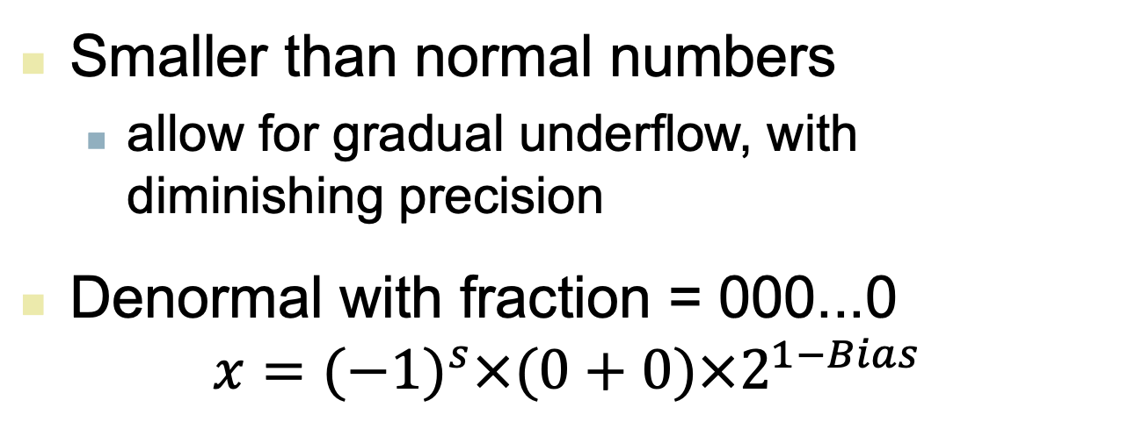
Denormal Numbers
Exponent = 000...0 ⇒ hidden bit is 0
$$x={(−1)}^{s}×(0+Fraction)×2^{1−Bias}$$
Smaller than normal numbers
allow for gradual underflow, with diminishing precision
Denormal with fraction = 000...0
$$x={(−1)}^{s}×(0+0)×2^{1−Bias}$$
Two representations of 0.0!

Slide 16
Infinities and NaNs
Exponent = 111...1, Fraction = 000...0
±Infinity
Can be used in subsequent calculations, avoiding need for overflow check
Exponent = 111...1, Fraction ≠ 000...0
Not-a-Number (NaN)
Indicates illegal or undefined result
e.g., 0.0 / 0.0
Can be used in subsequent calculations
Notes:
演示，dividedbyzero.c
mac上是float divided by zero: nan
linux上是：Floating point exception (core dumped)
C99标准6.5.5的第5条

Slide 17
Floating-Point Addition
Now consider a 4-digit binary example
1.000₂ × 2^{–1} + –1.110₂ × 2^{–2} (0.5 + –0.4375)
1. Align binary points
Shift number with smaller exponent
1.000₂ × 2^{–1} + –0.111₂ × 2^{–1}
2. Add significands
1.000₂ × 2^{–1} + –0.111₂ × 2–1 = 0.001₂ × 2^{–1}
3. Normalize result & check for over/underflow
1.000₂ × 2^{–4}, with no over/underflow
4. Round and renormalize if necessary
1.000₂ × 2^{–4} (no change) = 0.0625

Slide 18
FP Adder Hardware
Much more complex than integer adder
Doing it in one clock cycle would take too long
Much longer than integer operations
Slower clock would penalize all instructions
FP adder usually takes several cycles
Can be pipelined

Slide 19
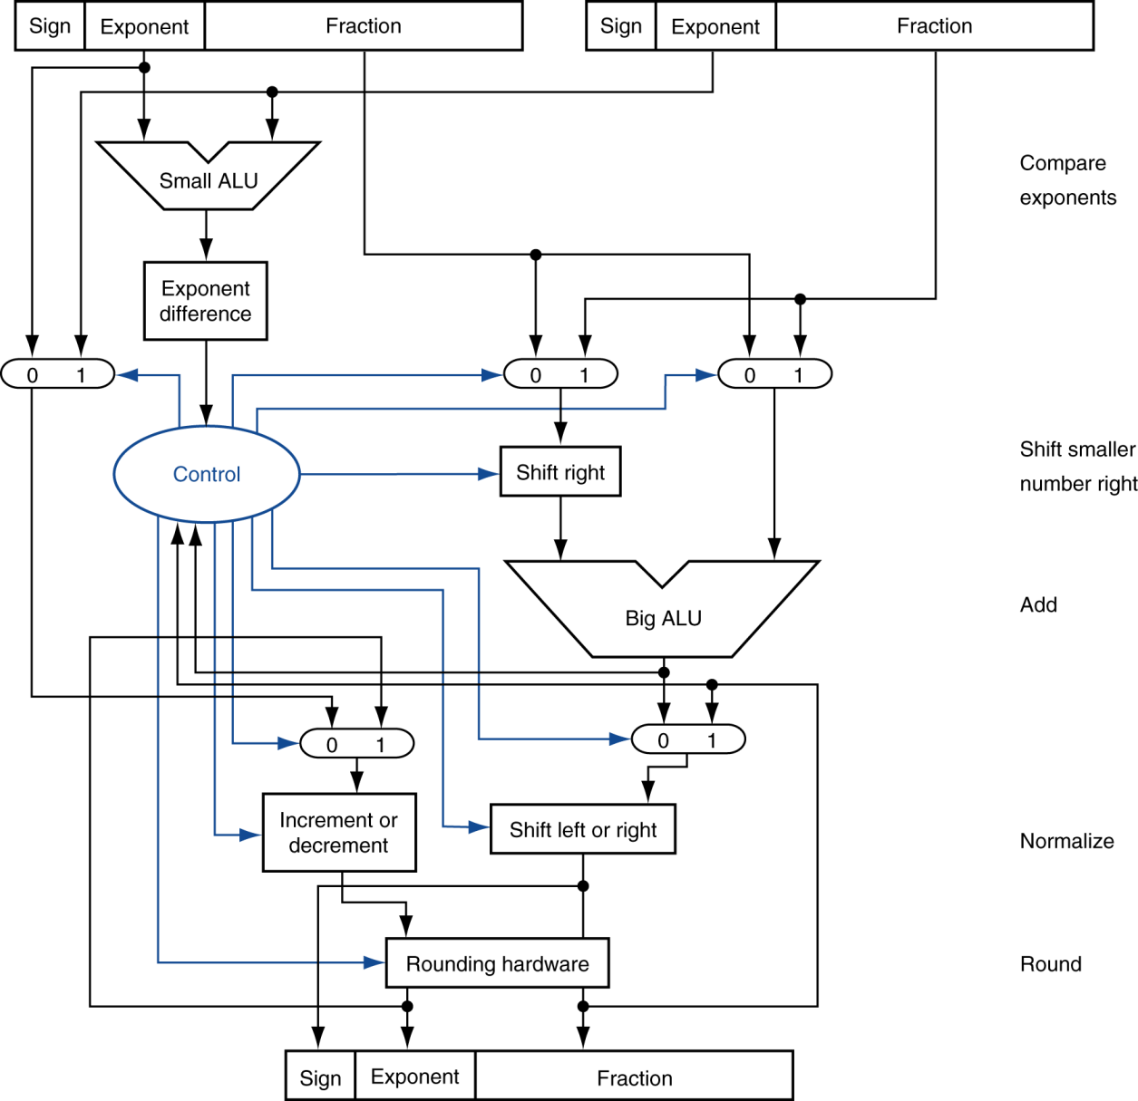
FP Adder Hardware
Step 1
Step 2
Step 3
Step 4

Slide 20
Concluding Remarks
Bits have no inherent meaning
Interpretation depends on the instructions applied
Computer representations of numbers
Finite range and precision
Need to account for this in programs
§3.10 Concluding Remarks

Slide 21
Concluding Remarks
ISAs support arithmetic
Signed and unsigned integers
Floating-point approximation to reals
Bounded range and precision
Operations can overflow and underflow

